Slide 1

Dynamic Tailoring for Teaching Social Skills Michael van Lent, Robert Marinier, Leon Pryor, Chris Kawatsu, Alex Nickels, Eric Tucker, Alex Pritchard

Slide 3
The Challenge
How can we approach the learning effectiveness of one-on-one instruction by a skilled teacher at the high throughput and low cost required by current DoD operational realities?

Slide 4
Hallmarks of Skilled Instructors
Real time assessment of the student
Student’s proficiency against the learning objectives
Student’s cognitive state relative to the zone of proximal development
Student’s level of engagement and motivation
Individualization to the student’s needs
Selection and ordering of instruction, demonstrations and exercises
Guidance and feedback provided to the student
Real time adjustments of demonstrations and exercises
Variation of the learning experience
Differentiation from the student’s past learning experiences
Adaptation of pre-existing demonstrations and exercises
Creation of novel demonstrations and exercises
Pursuit of a pedagogic plan
Development of a pedagogic plan based on curriculum and student
Tracking of student’s progress against the pedagogic plan
Direction of learning experience to implement the pedagogic plan

Slide 5
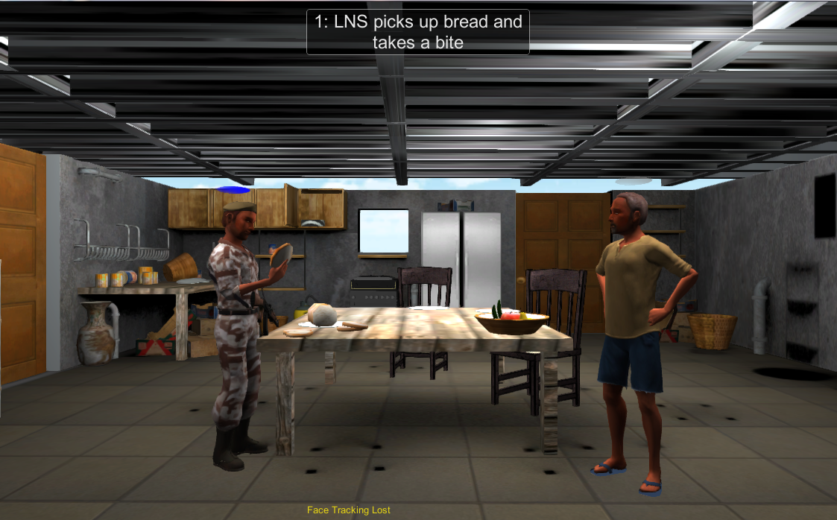

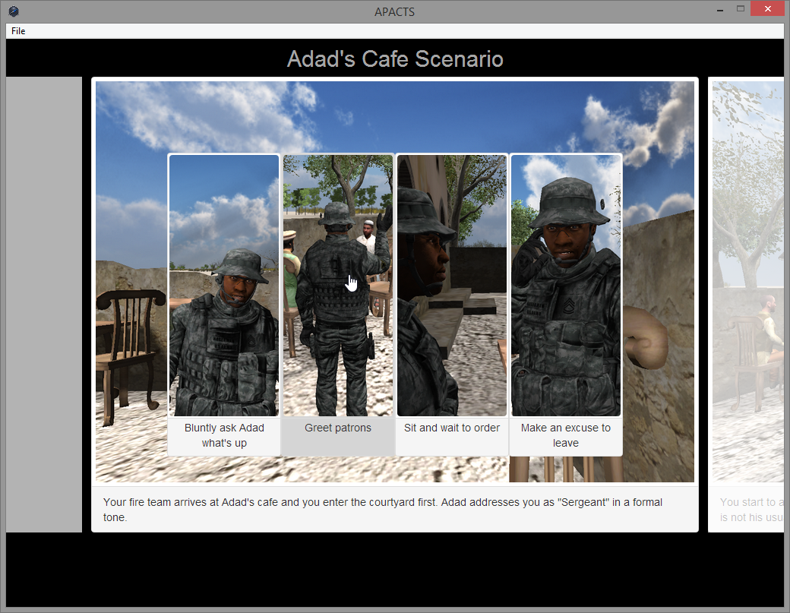
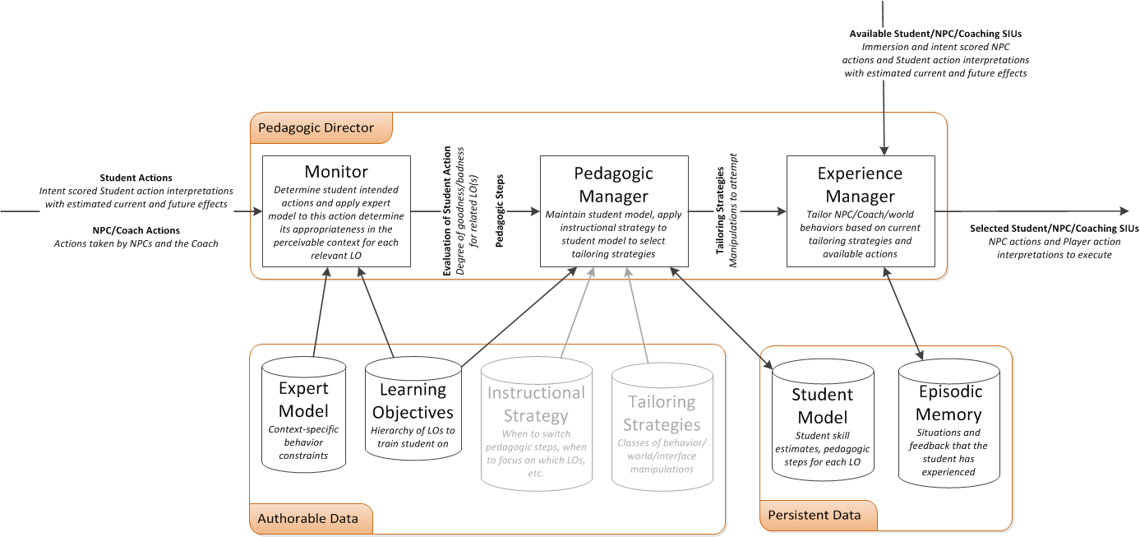
Dynamic Tailoring as a service
Raw Socket API
RESTful API
Annotated SIU Choices With Parameter Settings
Status Update Messages
Annotated SIU Choices With Parameter Settings
Status Update Messages

Slide 6
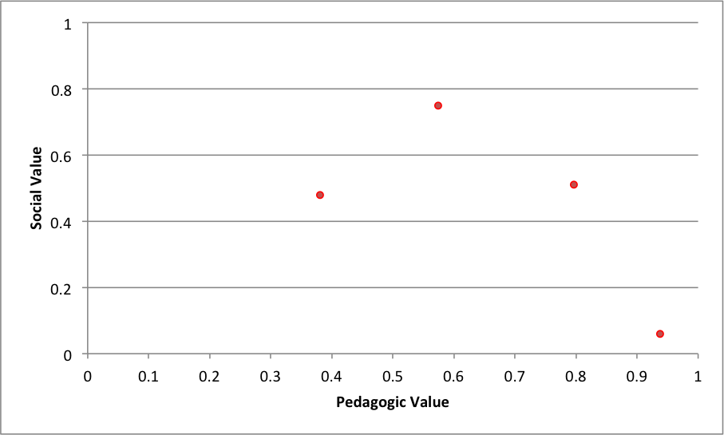
Dynamic Tailor Metrics (single choice point)

Slide 7
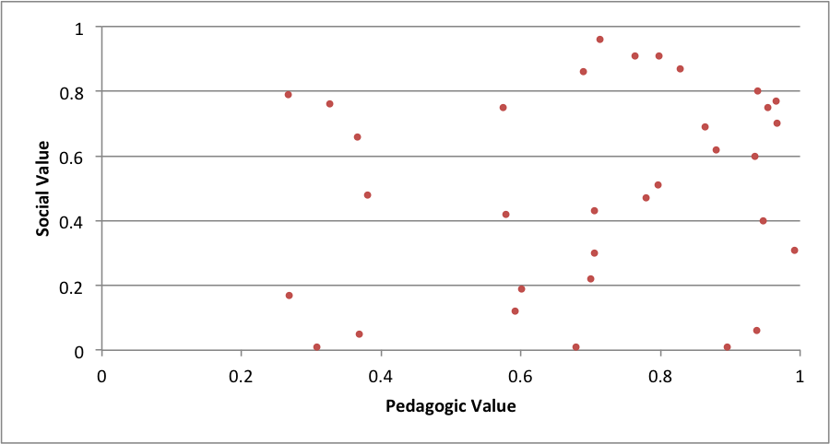
Dynamic Tailor Metrics (all choices)

Slide 8
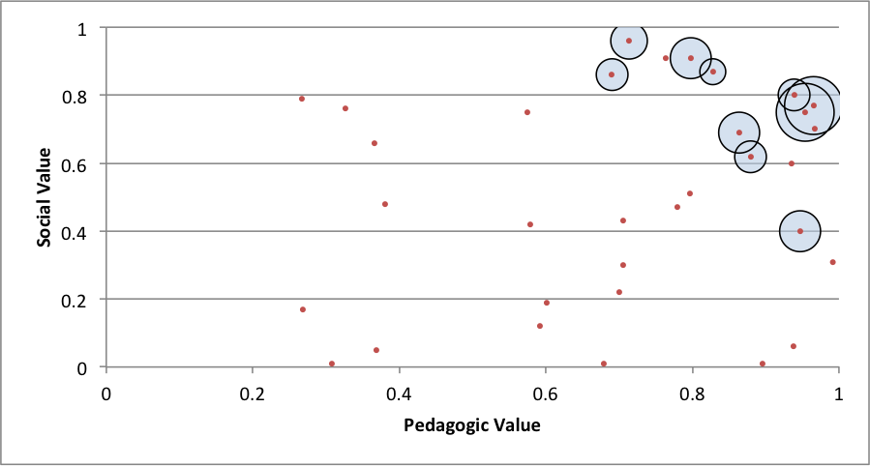
Dynamic Tailor Metrics (base performance)

Slide 9
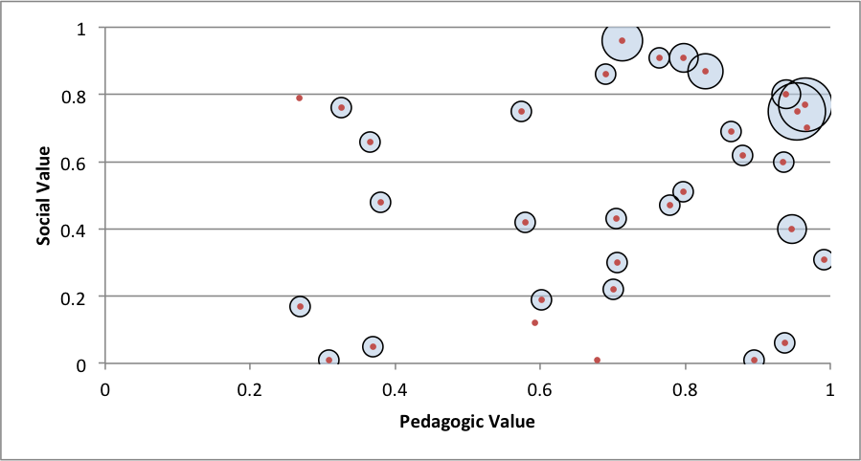
Dynamic Tailor Metrics (w/ episodic memory)

Slide 10
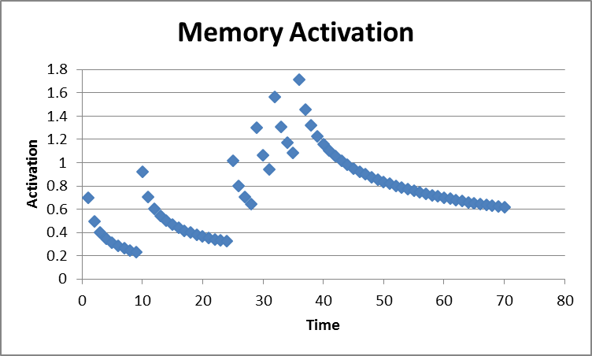
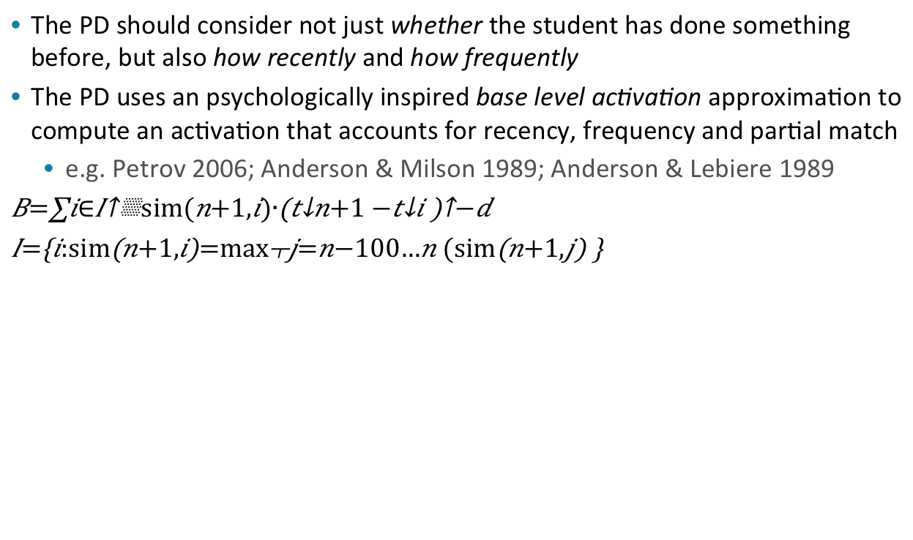
Episodic Memory Activation
The PD should consider not just whether the student has done something before, but also how recently and how frequently
The PD uses an psychologically inspired base level activation approximation to compute an activation that accounts for recency, frequency and partial match
e.g. Petrov 2006; Anderson & Milson 1989; Anderson & Lebiere 1989
$$B=\sum_{i∈I}{{sim(n+1,i)∙\left(t_{n+1}−t_{i}\right)}^{−d}}$$
$$I=\left\{i:sim\left(n+1,i\right)=\max_{j=n−100…n}{(sim\left(n+1,j\right)}\right\}$$

Slide 11
Dynamic Tailor Metrics (w/ episodic memory)

Slide 12
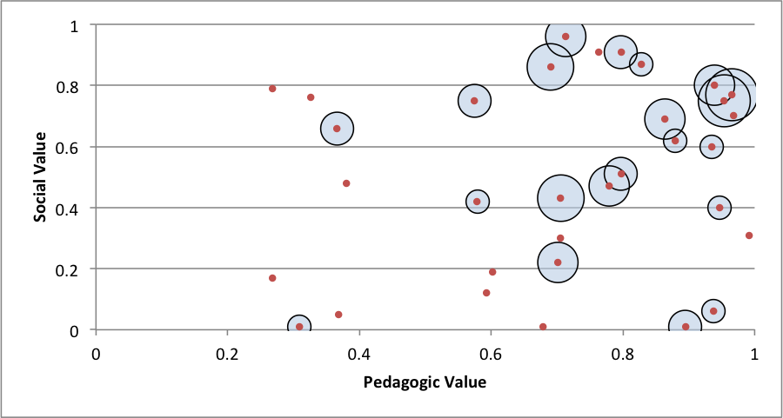
Dynamic Tailor Metrics (EpMem w/ Activation)

Slide 13
Nuggets and Coal
Gold Nuggets
Soar research is inspiring new ideas in other fields
Soar is a central component of the Dynamic Tailoring service
We’ve got the opportunity to deploy new training systems at Ft. Benning
Lumps of Coal
We’re not using Soar’s episodic memory
It’s unclear if we’re going to be able to run an experiment to test the training impact of increased variation

